Slide 1
Week 4 Updates Shapiro
By Evan Johns

Slide 2
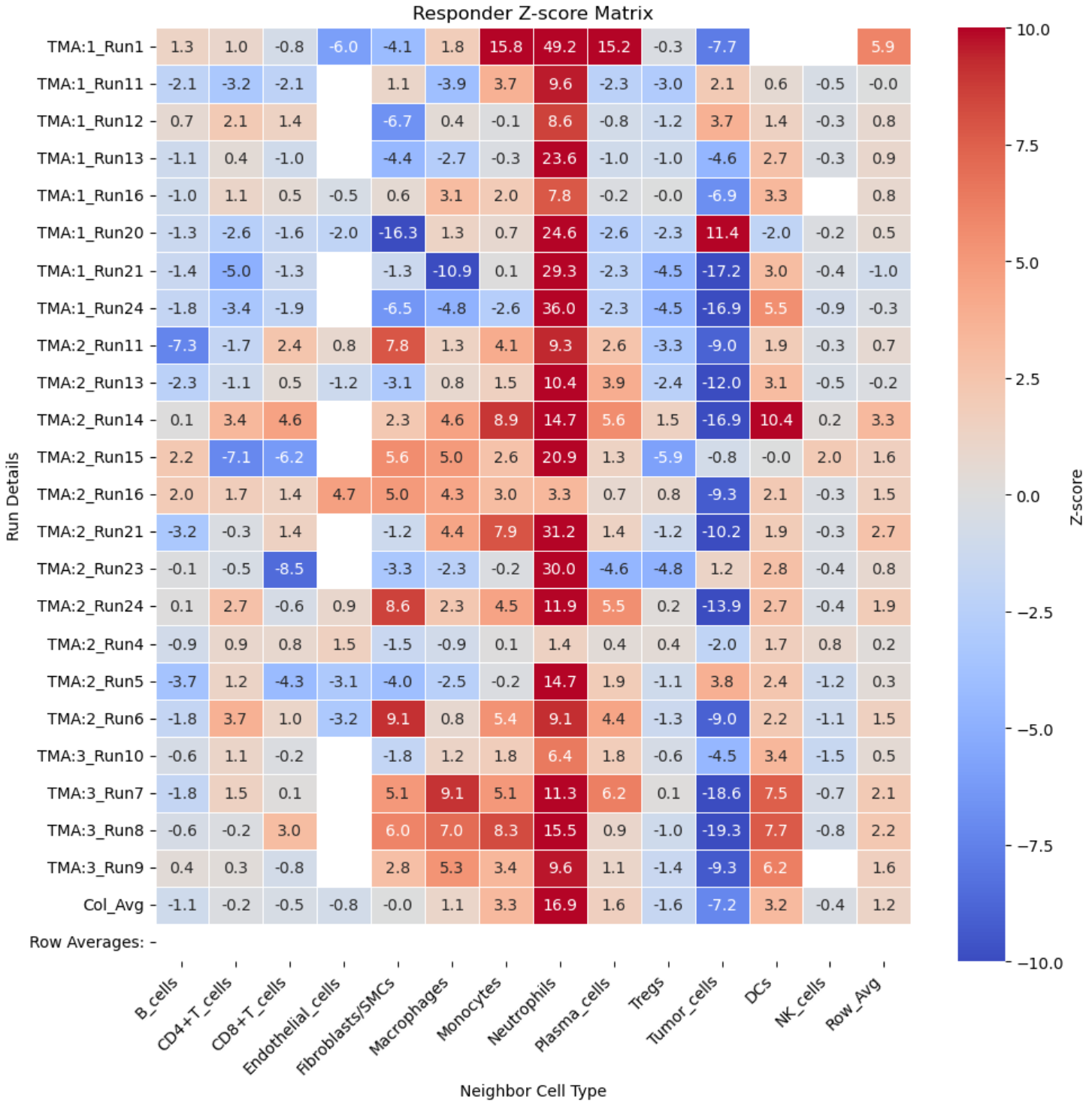
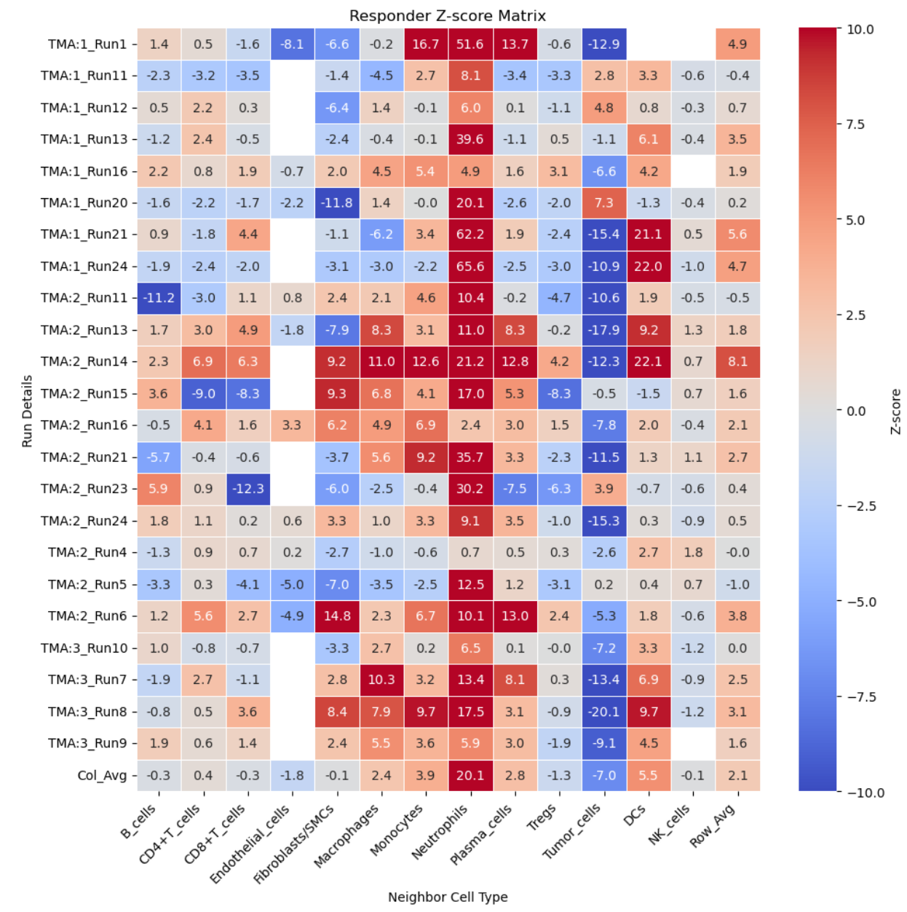
Protein Colocalization Analysis – Radial Comparison
Delaunay
Radial

Slide 3
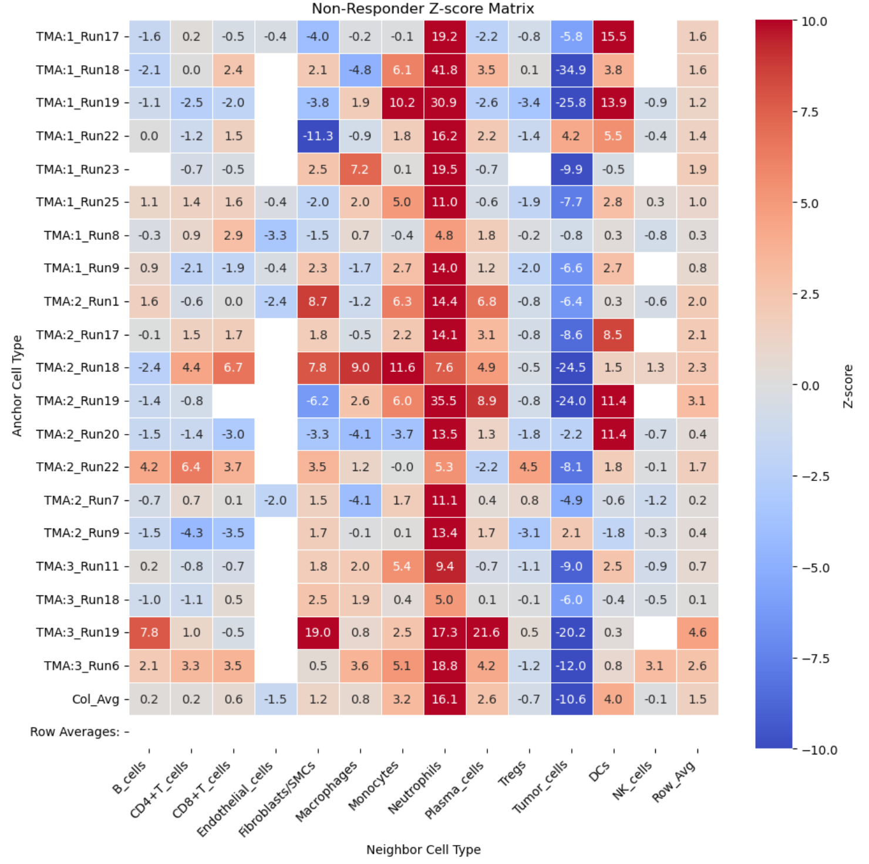
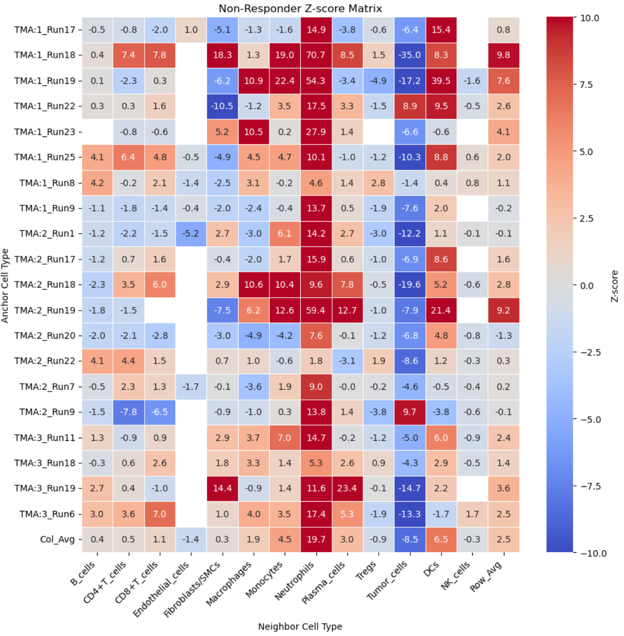
Protein Colocalization Analysis – Radial Comparison
Delaunay
Radial

Slide 4
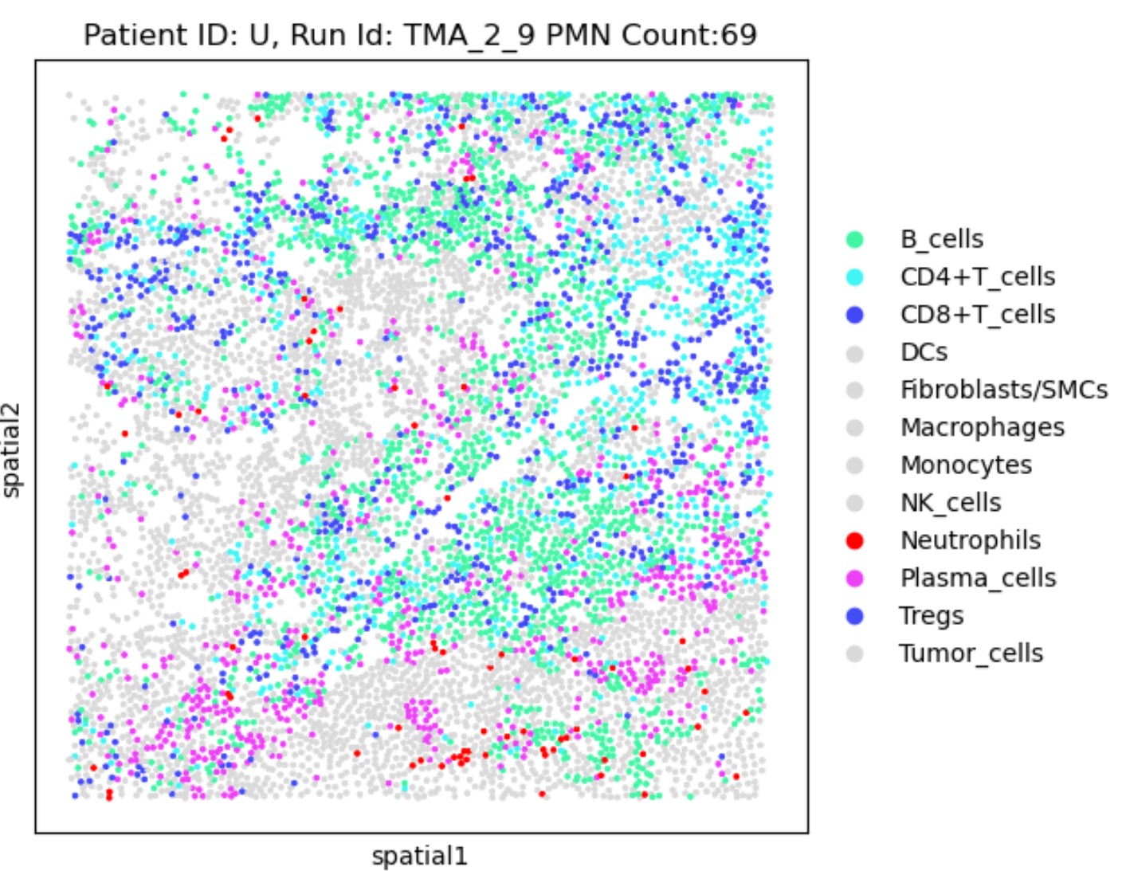
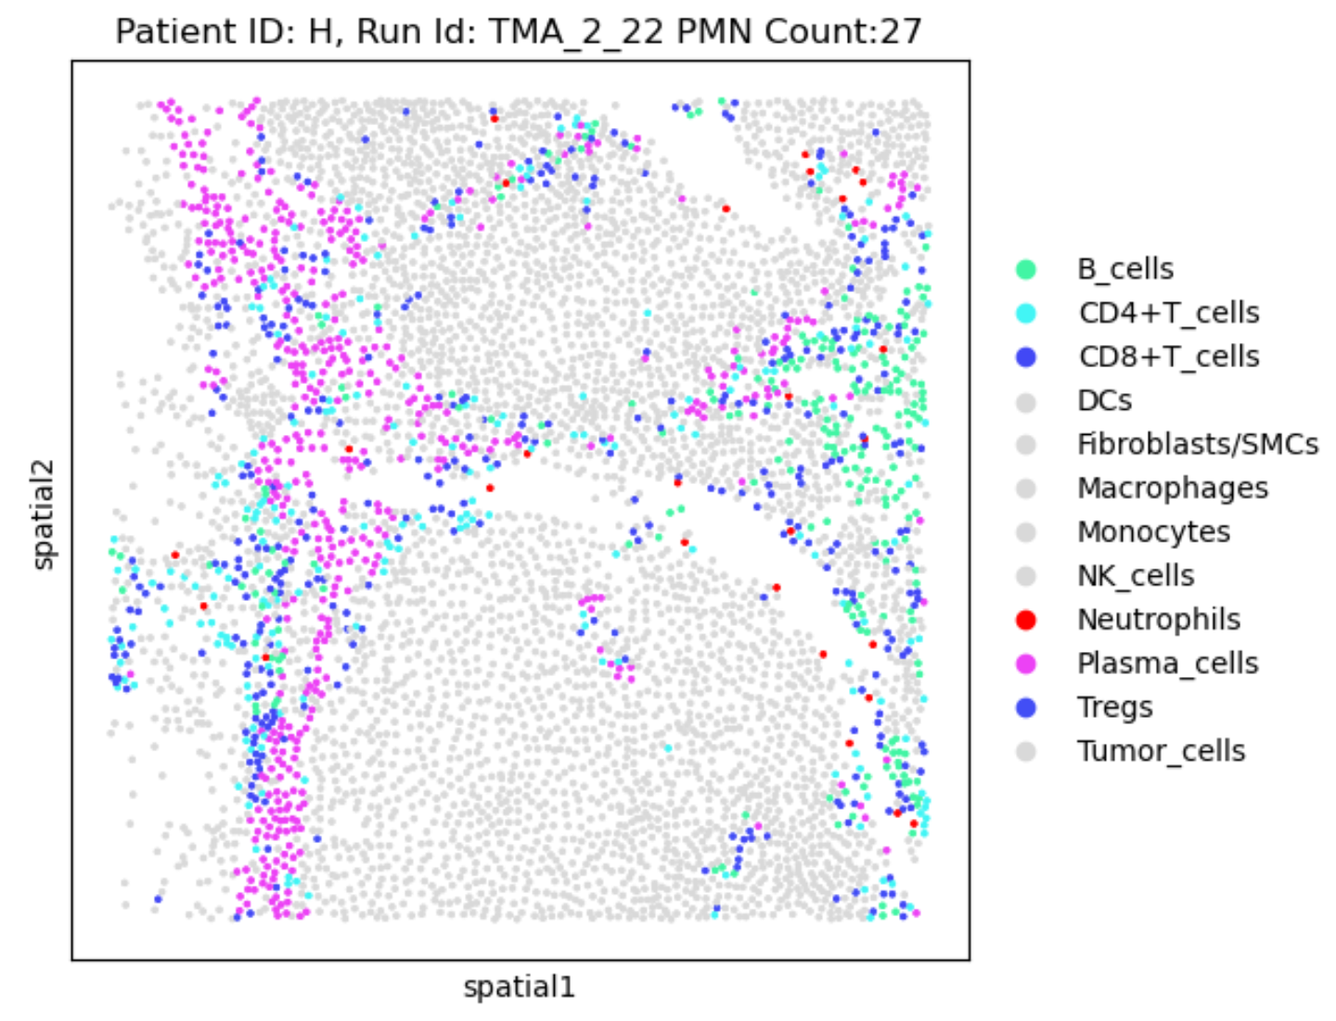
Colocalization Verification PMN-Immune interaction
Low Colocalization Delaunay -(CD4 -4.3, CD8 -3.5)
Radial – (CD4 -7.8 CD8 -6.5)
High Colocalization Delaunay -(CD4 6.4, CD8 3.7)
Radial – (CD4 4.4 CD8 1.5)
* Note: Both patients were responsive to treatment

Slide 5
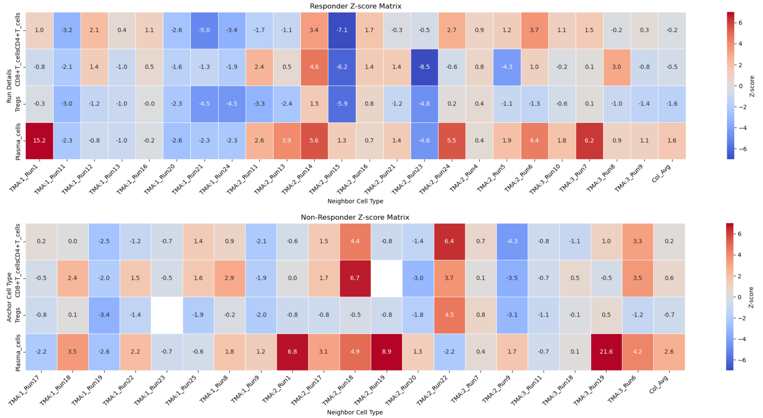
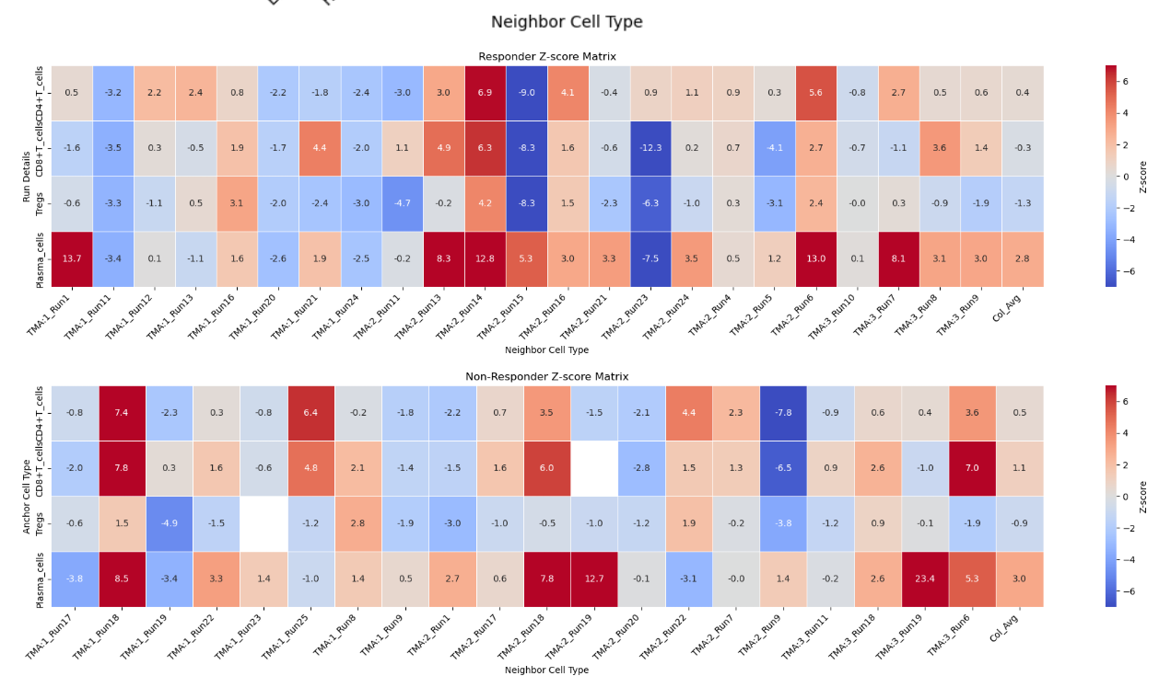
Radial vs Delaunay
Delaunay
Radial

Slide 6
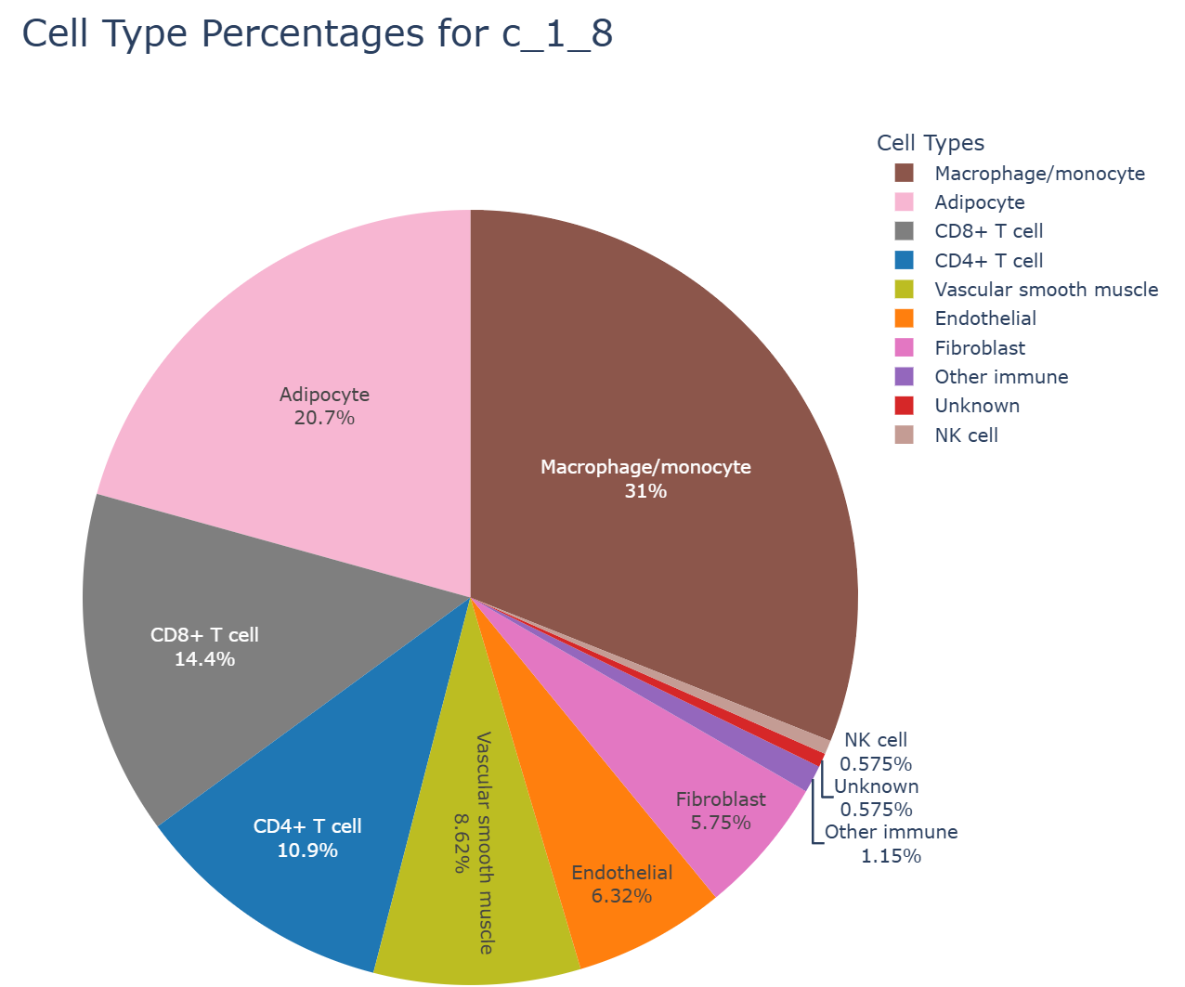
Neighboring Cell Types Graph
Method to show types of cells neighboring a sample’s PMNs
Works with radial, Delauney, and n_neighboors criteria

Slide 7
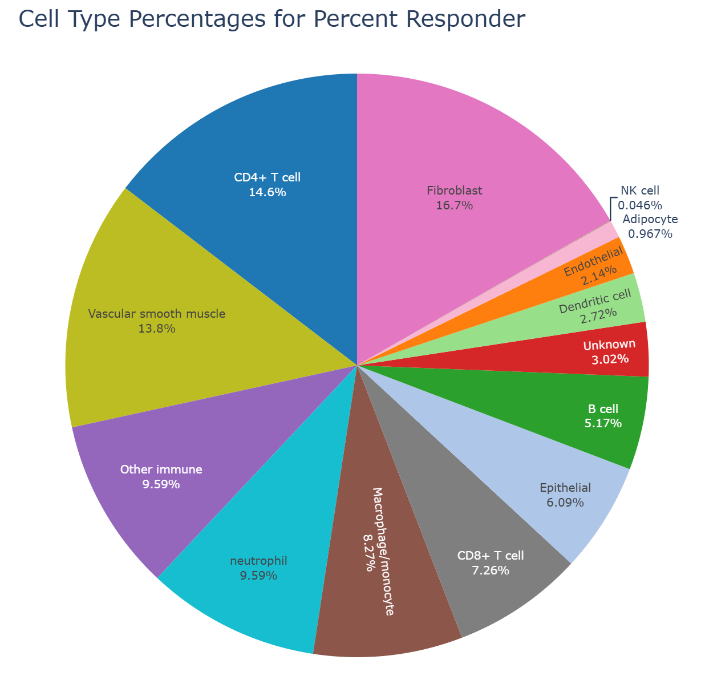
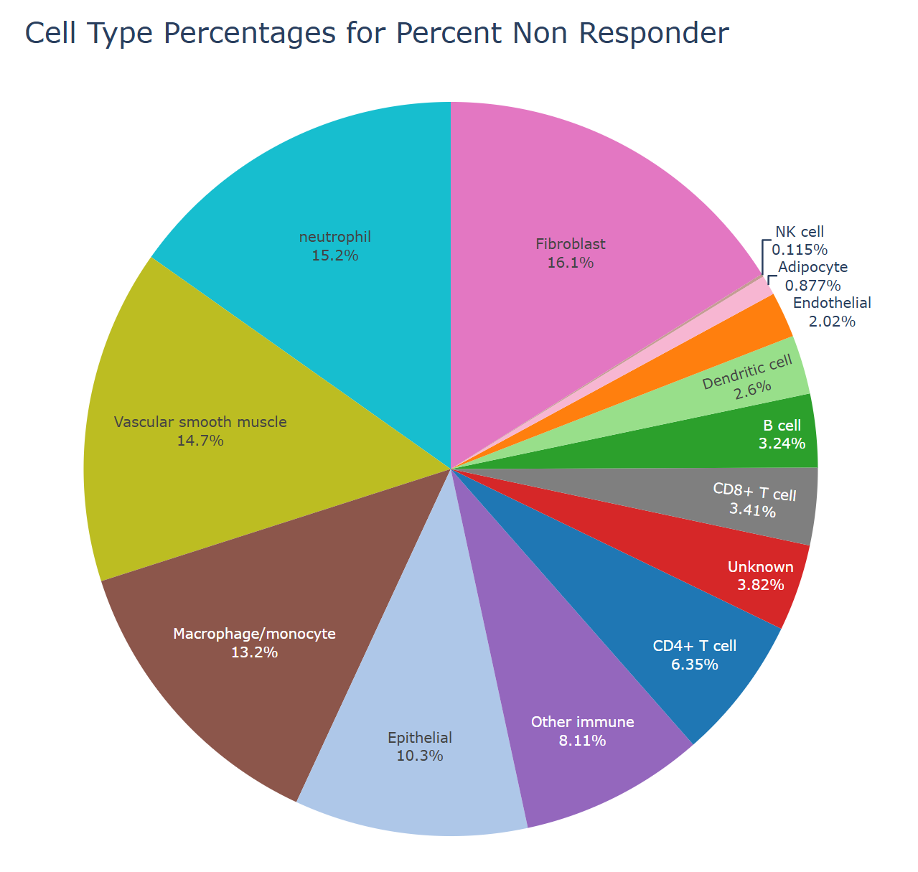
Neighboring Cell Types Responder vs Nonresponder (delaunay) – (cell type)

Slide 8
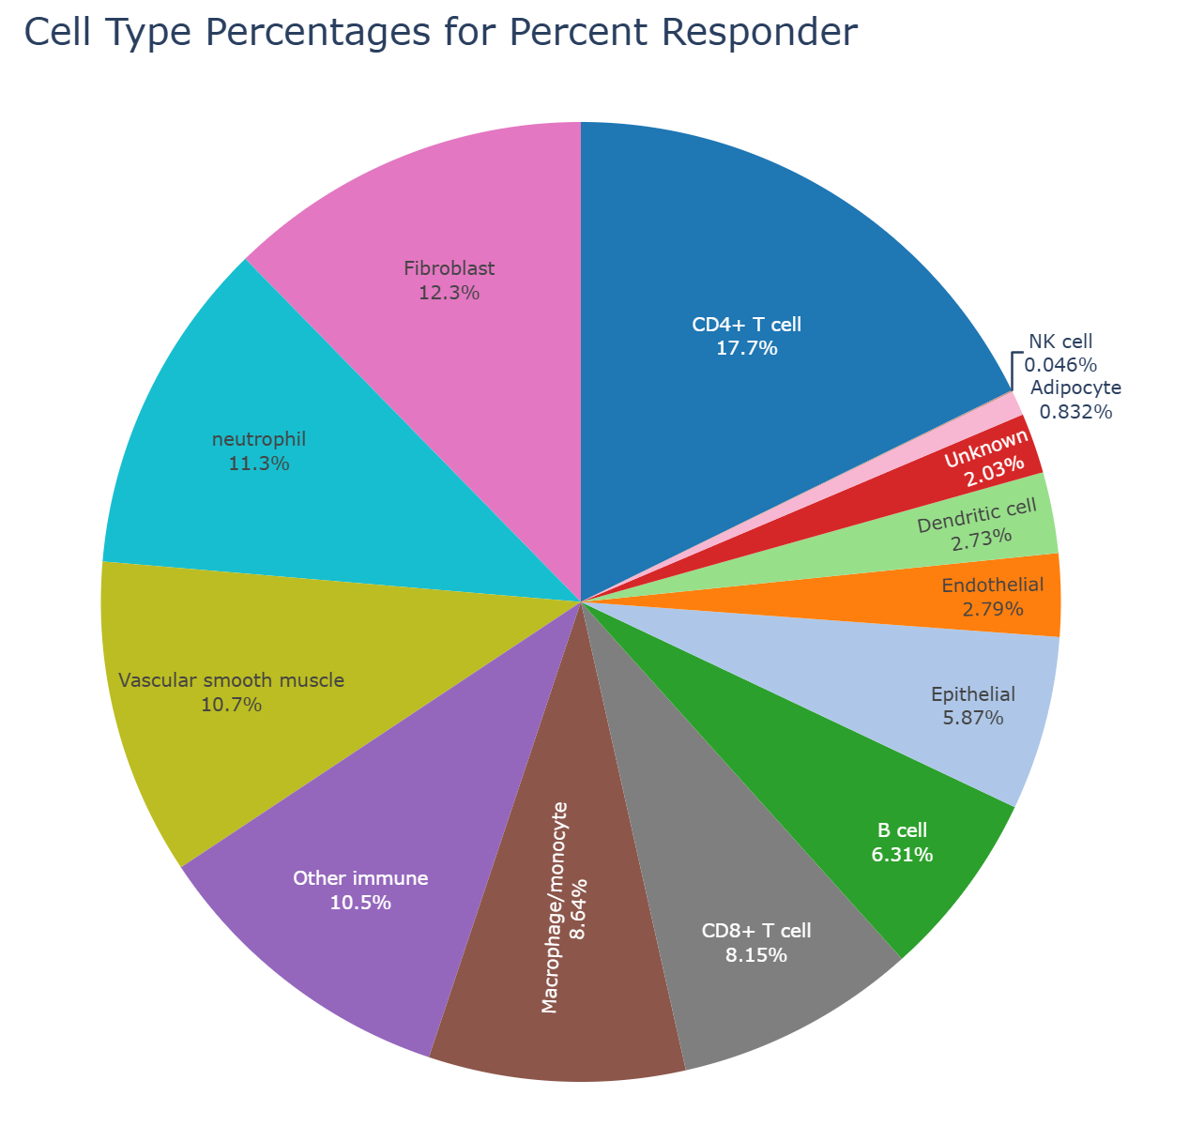
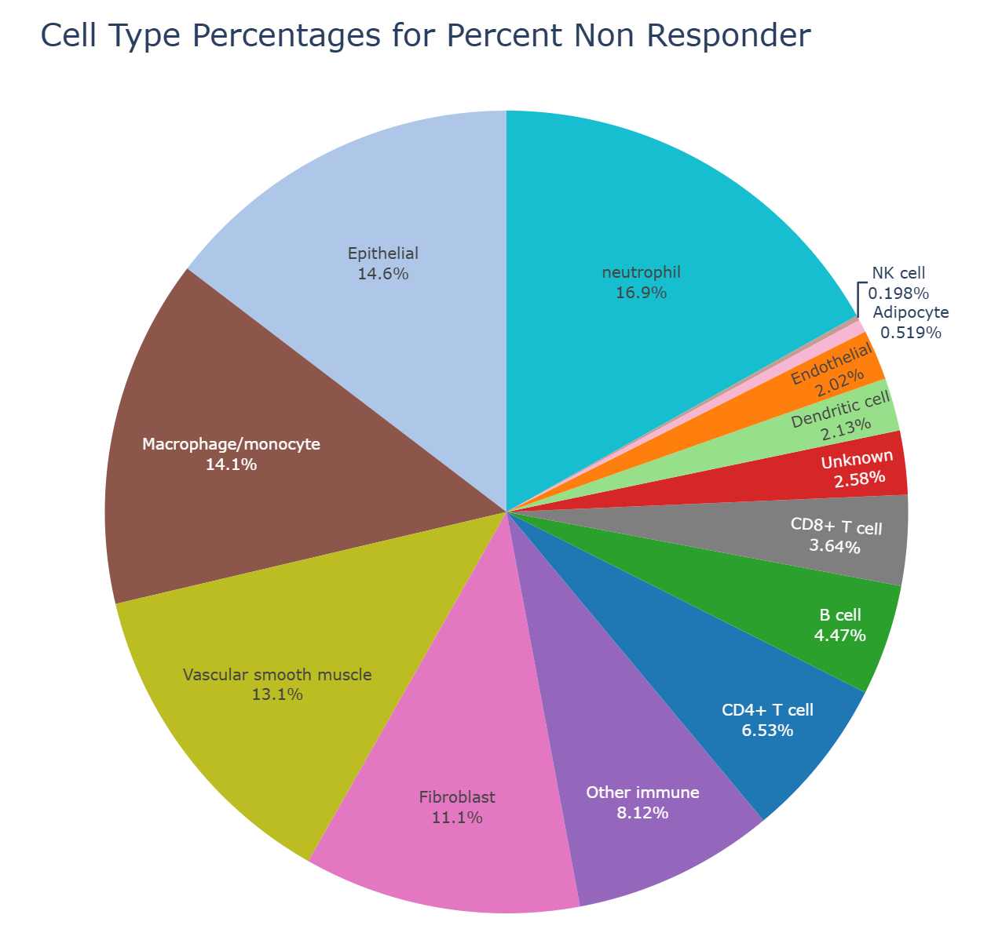
Neighboring Cell Types Responder vs Nonresponder (radial 21 microns) (cell type)

Slide 9
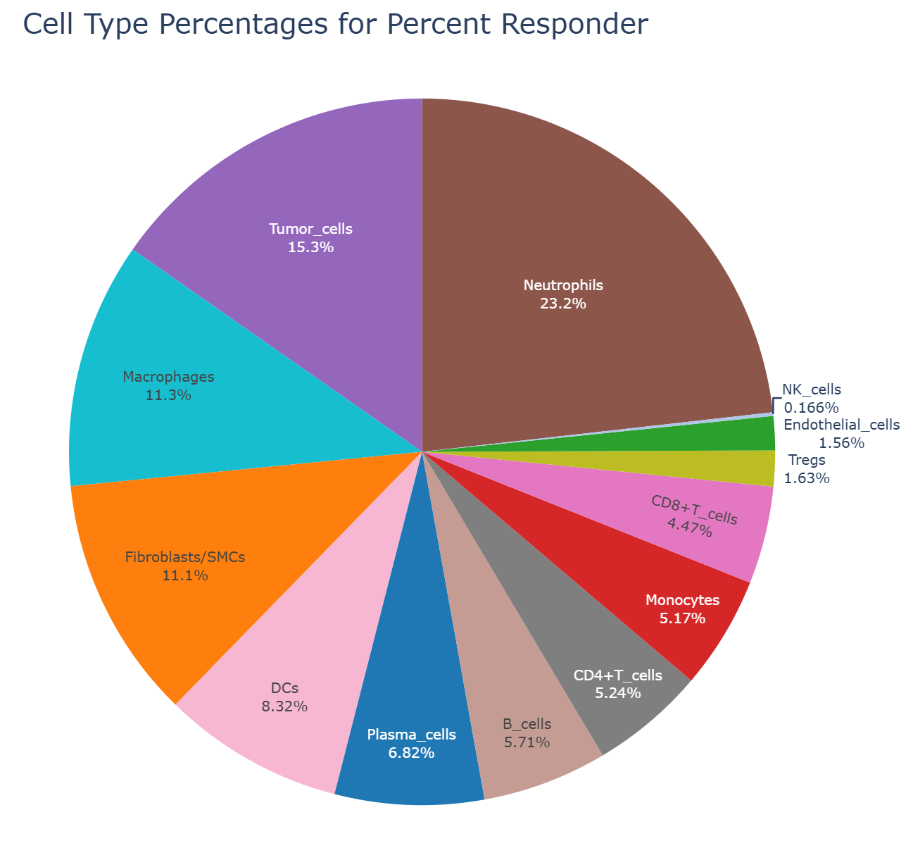
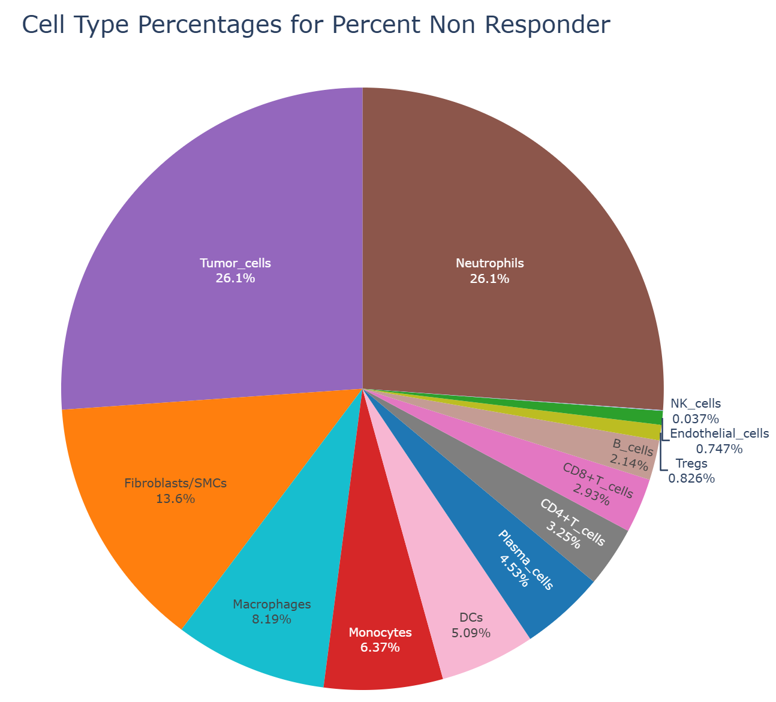
Neighboring Cell Types Responder vs Nonresponder (21 microns) – (merged annot cluster)

Slide 10
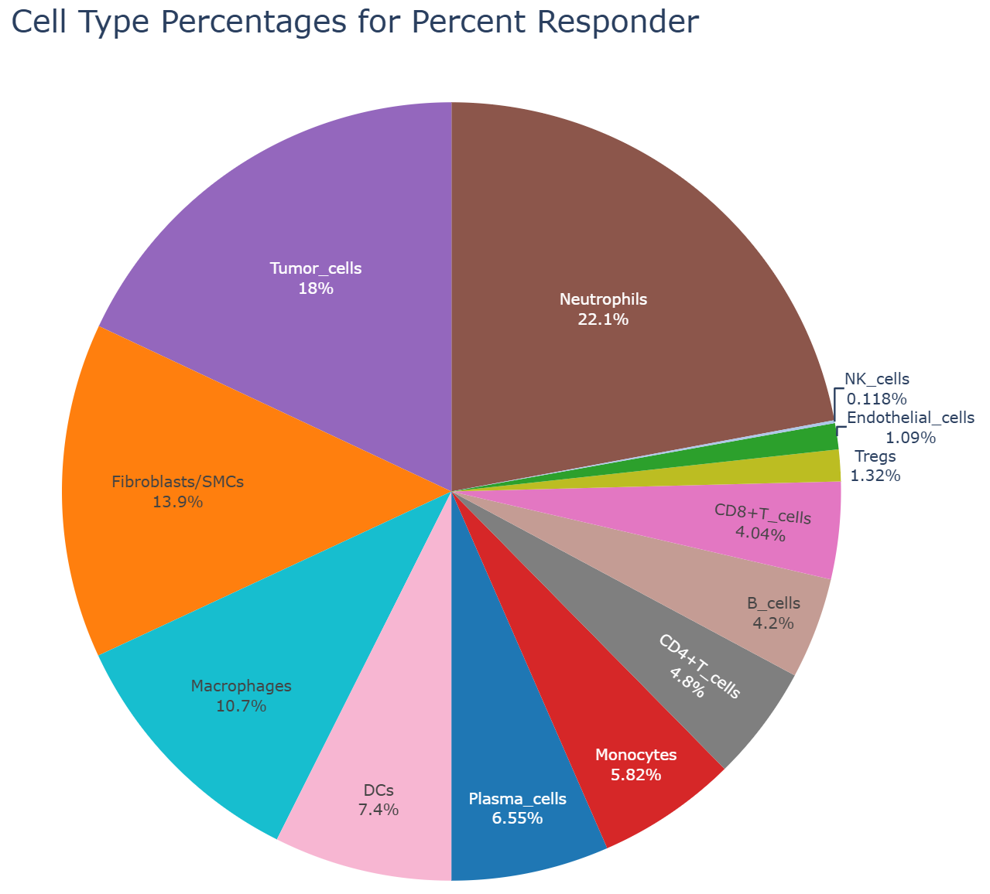
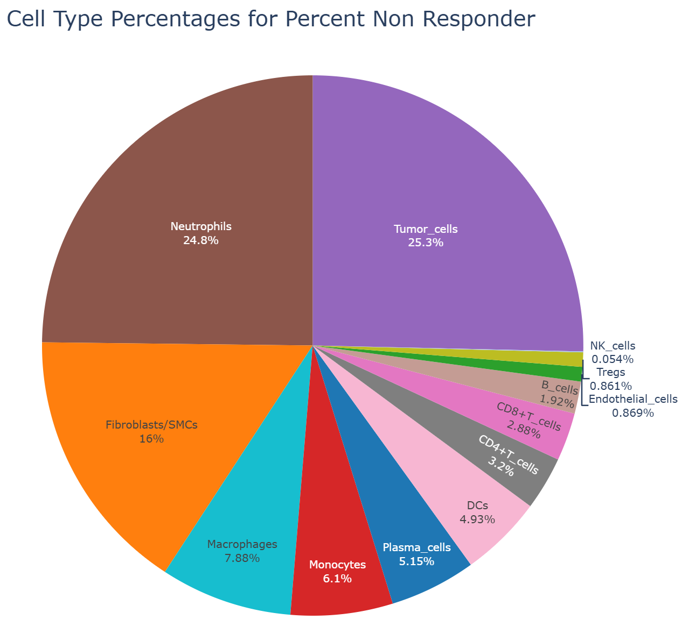
Neighboring Cell Types Responder vs Nonresponder (delaunay) – (merged annot cluster)

Slide 11
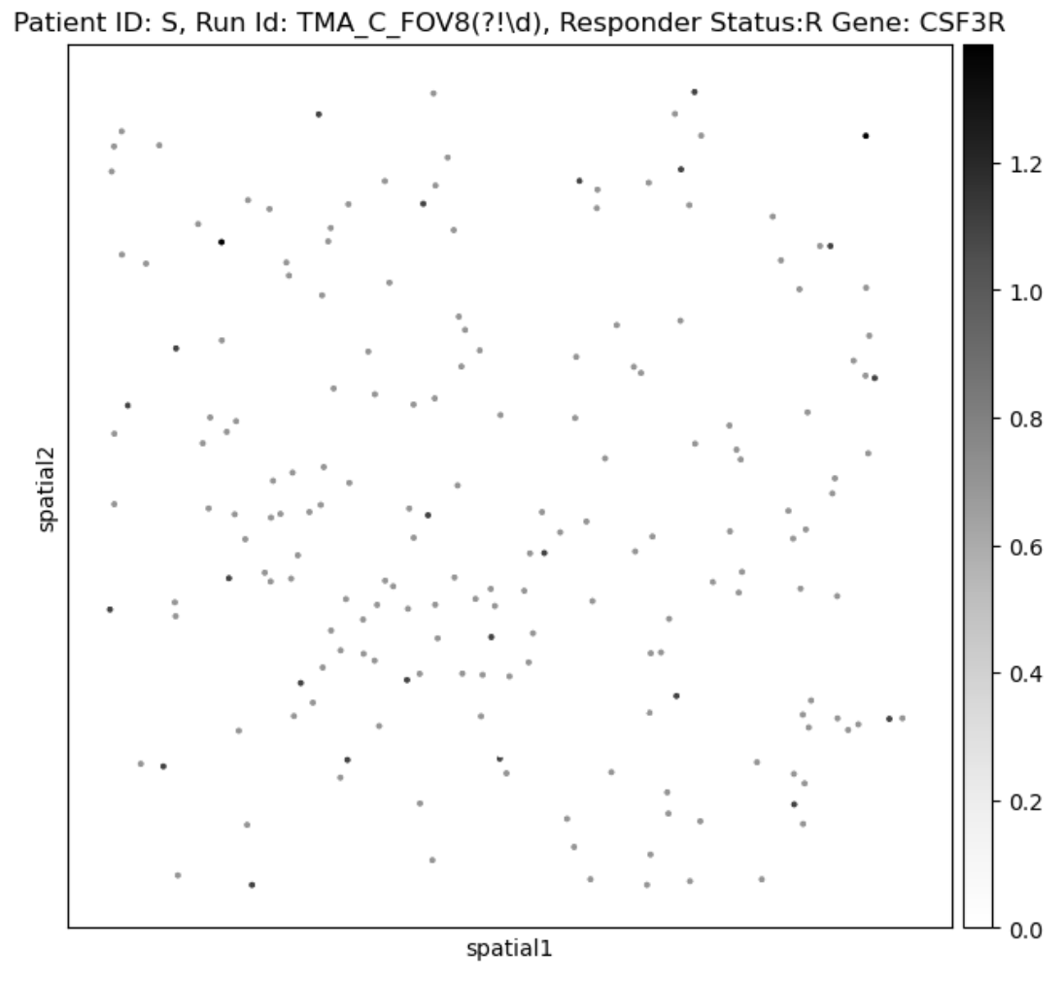
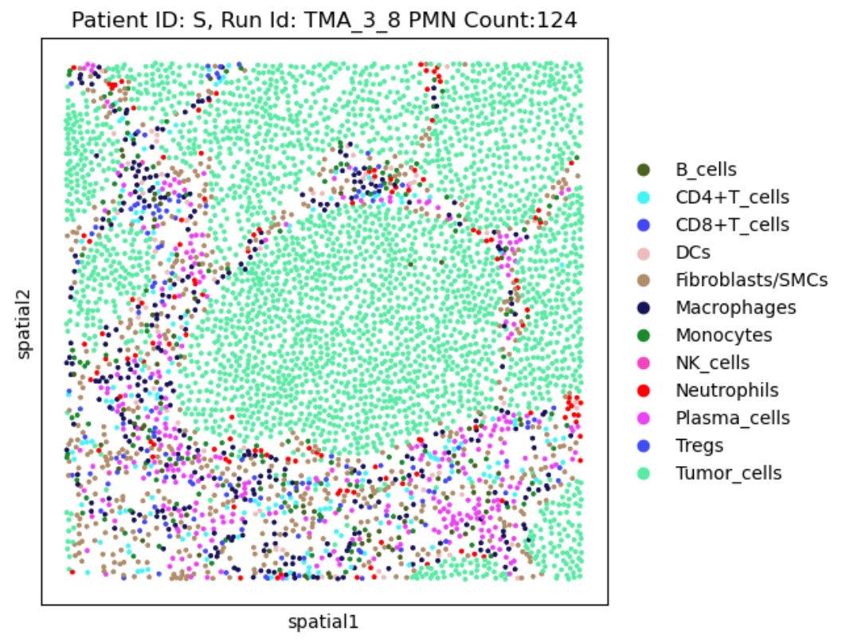
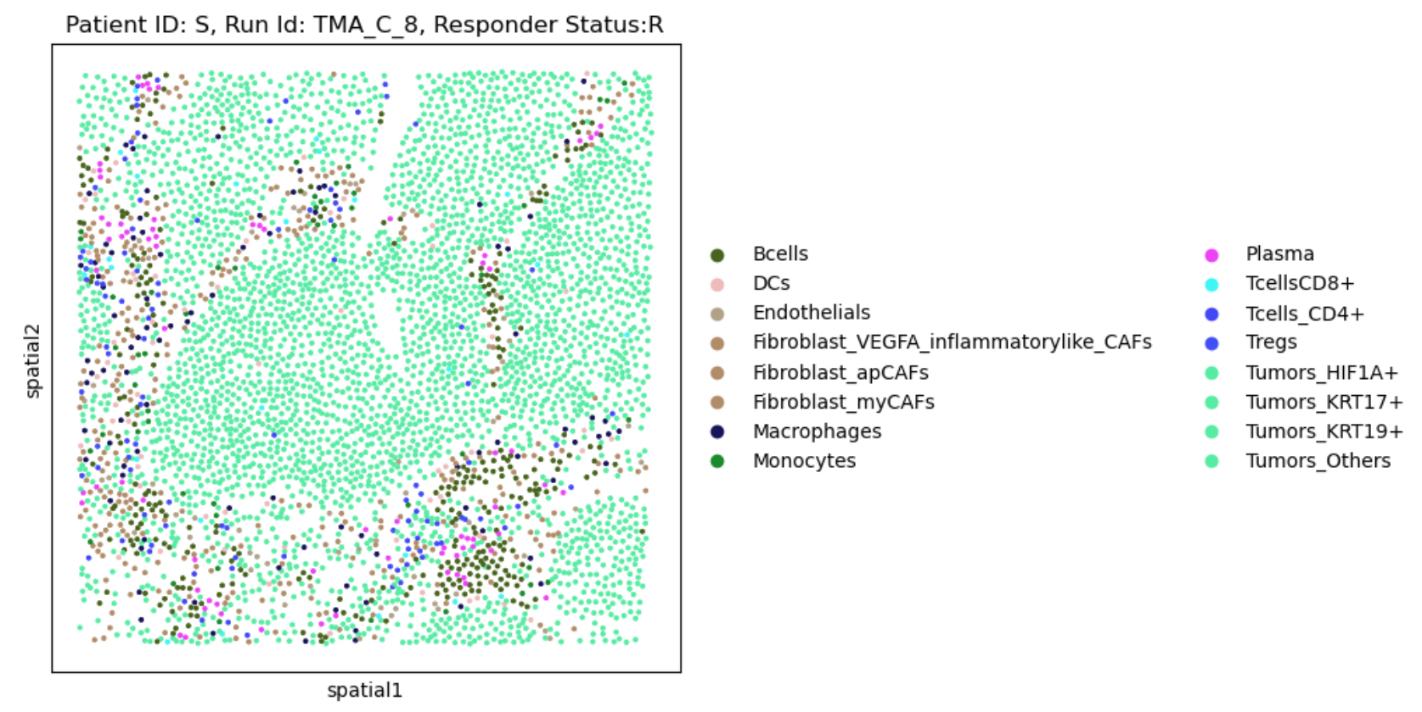
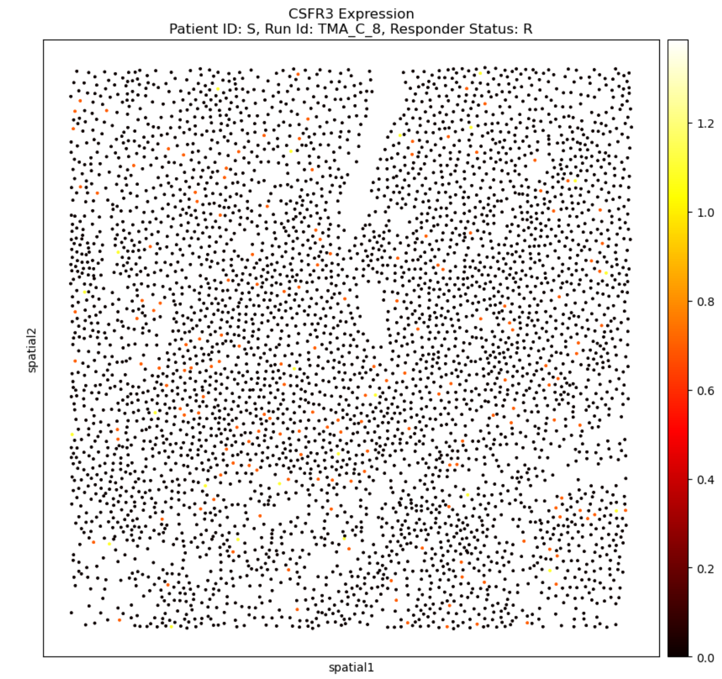
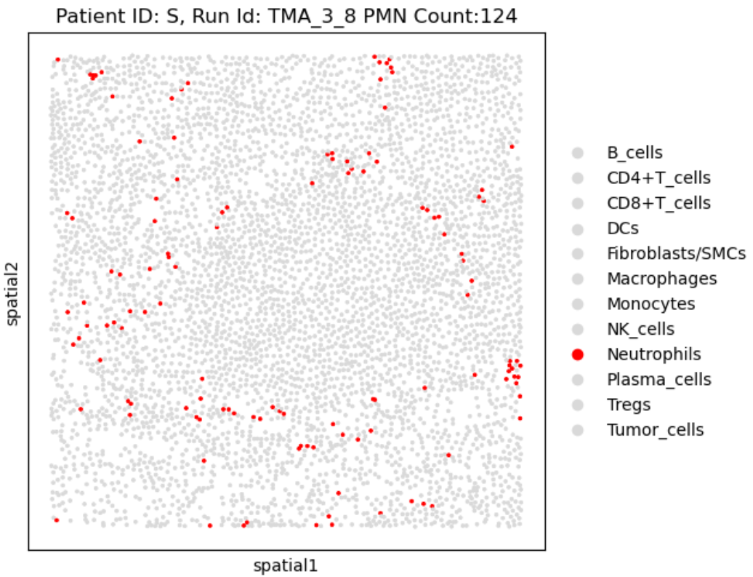
CSFR3 Gene Expression
Possible PMN marker – no good link
Protein
mRNA

Slide 12
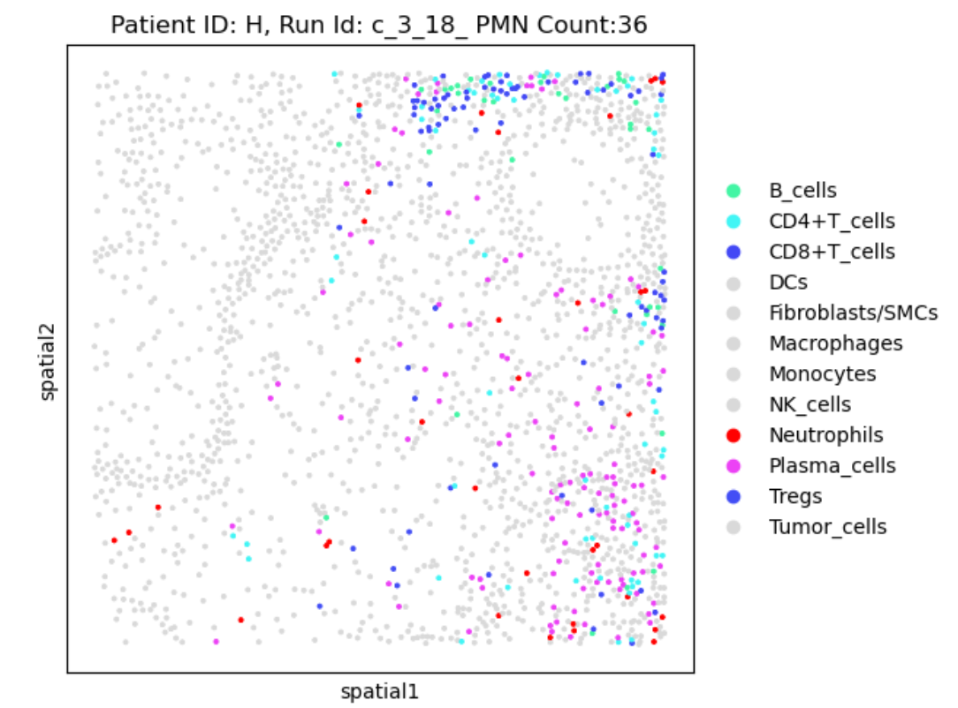
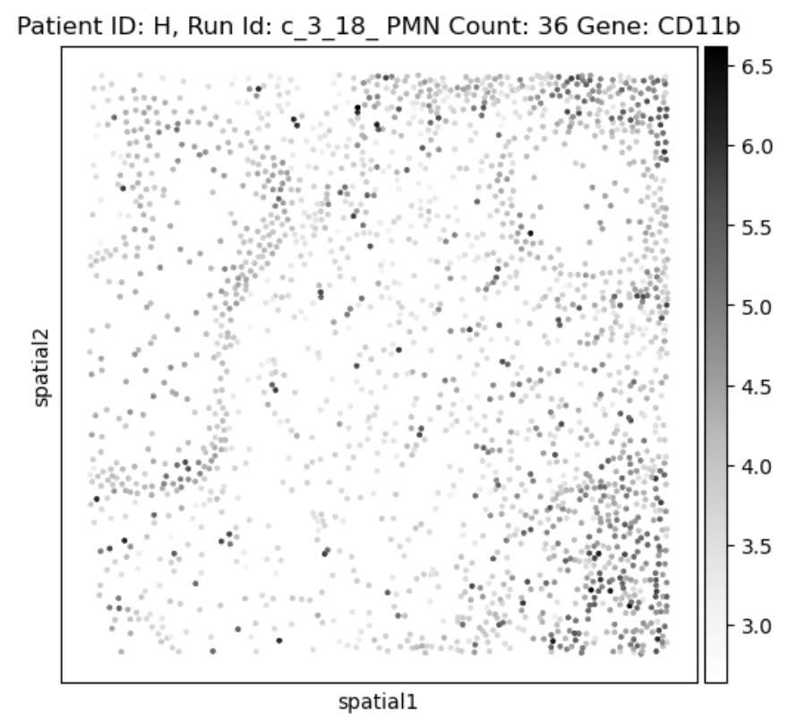
Protein Mapping Expression Validation (CD11b PMN Marker)

Slide 13
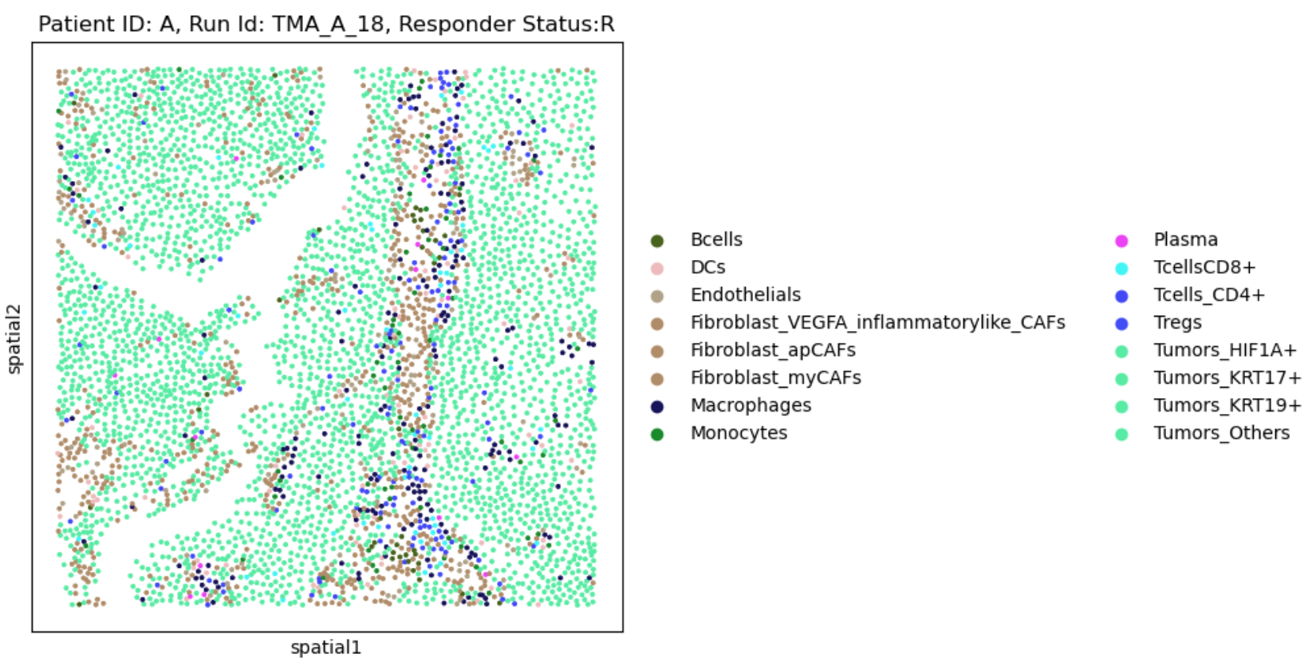
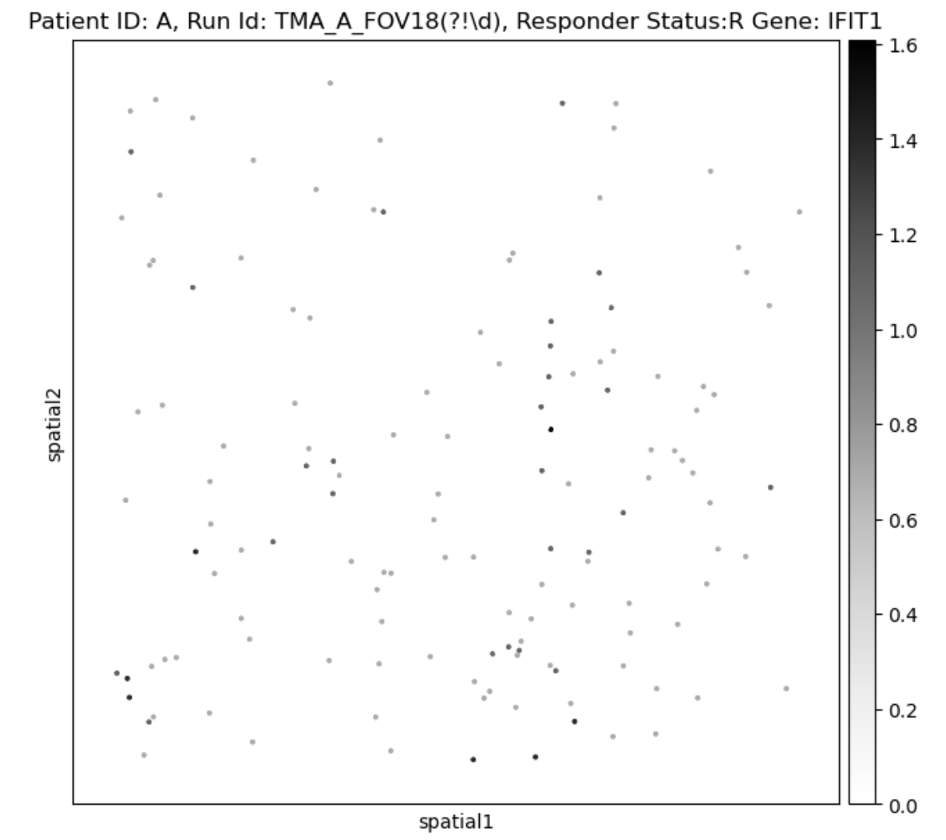
IFIT1/2

Slide 14
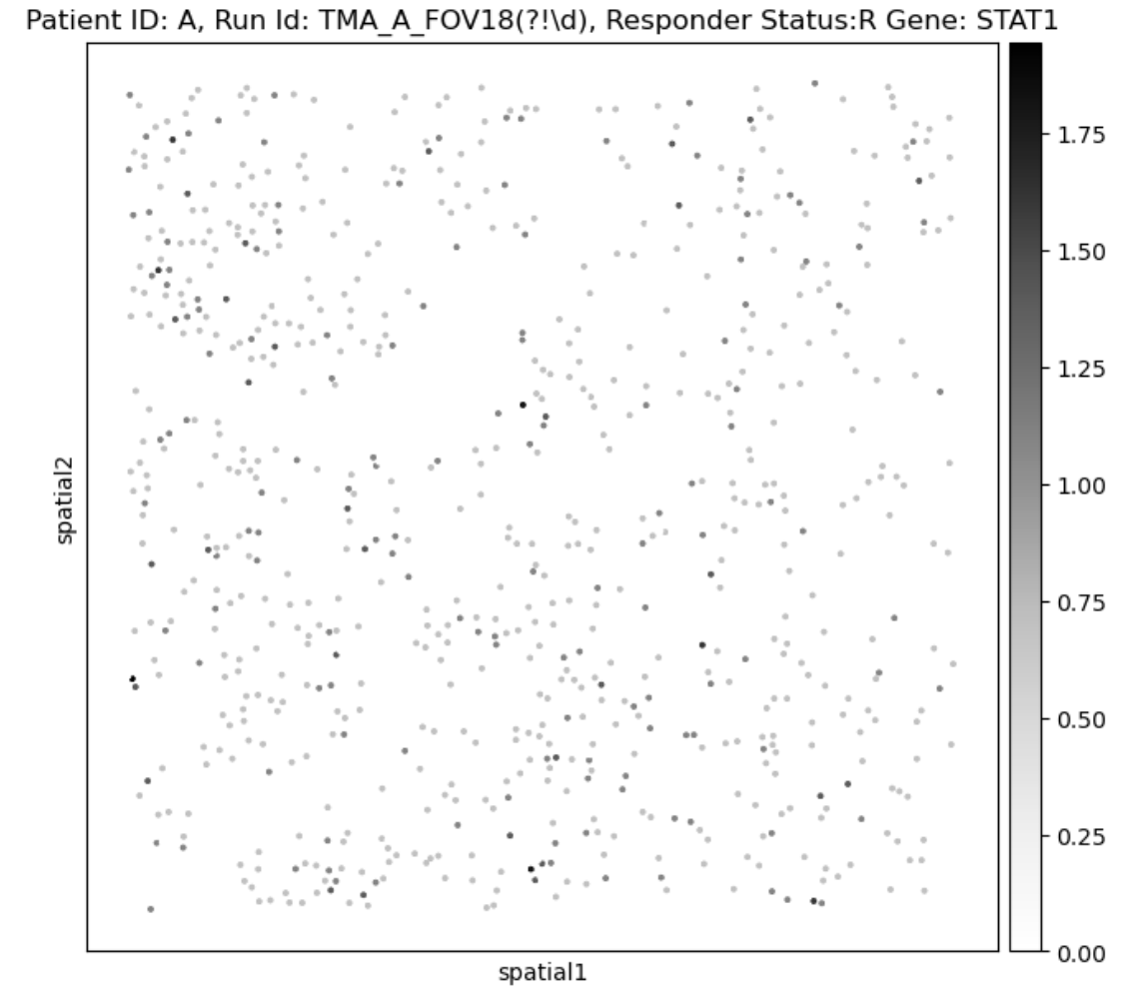
STAT1/2

Slide 15
ISG15/20, IFIT1/2, STAT1/2
Steps
Cleanup Code Base
Make Percentage Matrix
Create Heatmap of Percentage Matrix (Heatmap 1)
Create Heatmap of the delta vs general sample (Heatmap 2)

Slide 16
Next Steps
Determine how far PMNs are to the nearest CD8 and CD4 cells.
Clustering matrix by protein expression
Analyze T cell neighbors

